Slide 1

TM
ShoutOut is a virtual bulletin board application.
You can post or message, anyone at anyplace.
Michael Chung
chungmojo@gmail.com
Aug 2018

Slide 2
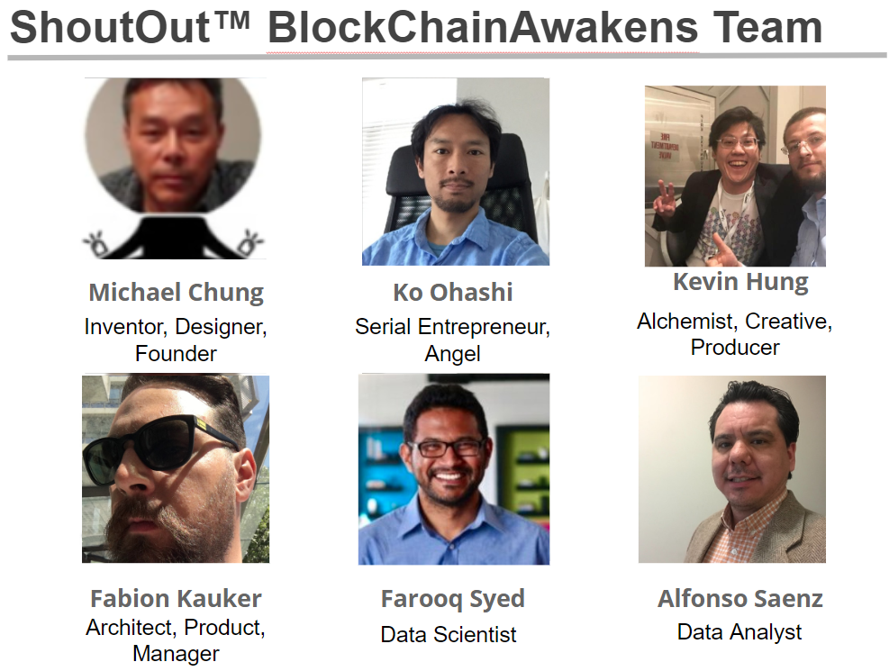
We came,
we met,
we built.
Awesome
experience!
Linkedin ID:
chungmojo

Slide 3
ShoutOut™ is…
What: We are a places focused communication platform to enable anyone to broadcast to or connect with others who are at the place or are interested in the place.
Problem: The general problem to solve is to make it easier to do shoutouts or make announcements to others; or as a visitor, to connect to others.
Difference: A “slack for places” or “facebook wall for places” - we are a places based open communication and people connection platform, an out-of-network communication channel.
Why: The benefits include to instantly communicate and connect with others who are at or interested in the place.
Mission: To be the be first location based communication solution and solve the last remain digital gap in our communication channels, the location.

Slide 4
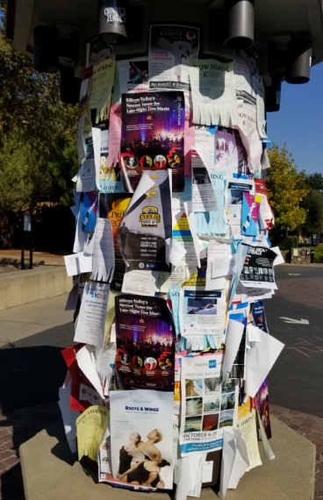


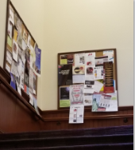
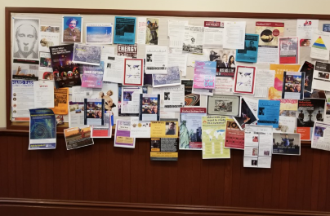
ShoutOut™ is the next generation bulletin board.
Problem to be Solved:
Paper based bulletin boards is an oxymoron in our digital age. We need a digital solution.
The Question:
Why does it persist, even at the the mostest-bestest-digitalest place in the universe: Google offices (LOL!); and Stanford, Philz, etc.
Actual Photos!

Slide 5
ShoutOut™, is places focused…
Broadcast your announcement or message and have a dedicated channel with 2 clicks.
Open the application at the place, and talk with anyone.
Where ever you are, connect instantly and be part of the community.
(The Rule of 3; and me channeling Steve Jobs)
ShoutOut is like posting flyers on bulletin boards at places or doing shoutouts, a bit like a bullhorn if warranted, with your messages at a place.

Slide 6




Why the need? A location/places based out-of-network communication channel – for colleagues, visitors, and marketers.
TM
Benefits: Do shoutouts to any place, get direct help and information; earn ad-incentivized tokens.

Slide 7


In the last 100,000 years, the bulletin board technology has evolved from:
to
The State-of-the-Art.

Slide 8
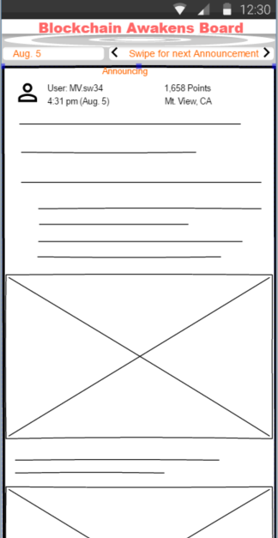
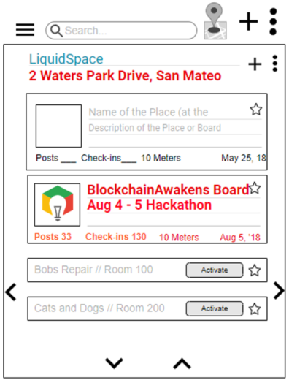
ShoutOut™: MVP UIs
Faster
Easier
Cheaper
More accurate
Slack, fb

Slide 9
A) Marketers and ADs drive the token economy Opt-in ads on the Boards will be the primary fuel for the ShoutOut tokenization and tokenomics. “The total impact of advertising represented 19% of US GDP”. (Economic Impact of Advertising Study.) B) User behavior: Rewards, incentives, and credits Participating users are directly rewarded and incentivized. (BAToken, Steemit, etc.) C) ShoutOut platform – 100% smart & decentralized To be decentralized & smart contracts admin’d; the platform and devs earn fees from smart contracts; entire revenue model is smart contracts controlled.
BD: Physical + Virtualization App + Tokenization
Users earn tokens with 2 behaviors:
1) Participation and contributions.
2) Engagement (opt-in) with the marketing adverts.
Social Impact: Breaking down the monopoly of content monetization.

Slide 10
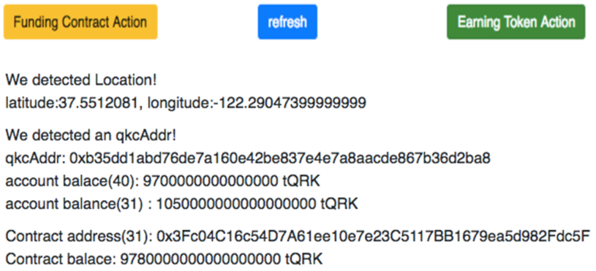
QuarkChain – 2 benefits for our POC
Demo Objectives and Purpose:
A) Technical POC of instant transactions on QuarkChain via strategy of aggregating all same geo-regional ShoutOuts on one QuarkChain shard.
1) Near instant if within the same shard.
2) 90 seconds if cross shards – use case: ShoutOut Boards are on one shard based on regions - North America, China, India, Central America, etc.
B) QuarkChain enables – Utility and Emotional benefits:
Two strong Value Propositions for ShoutOut.
Utility (Functional) – increased use cases, increase activities.
Emotional (User experience, brand hooks) – faster is greater satisfaction, and one of the biggest value drivers of any service.

